Slide 1
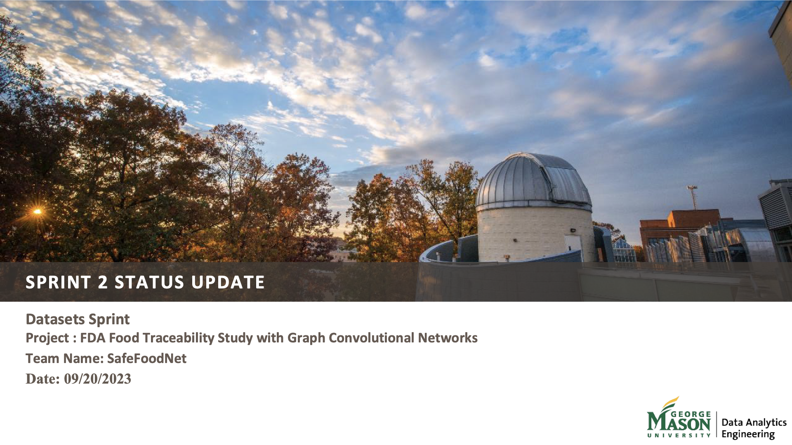

Slide 2





TEAM MEMBERS
Aidin Ziaee
Scrum master
Sindhuja Nainapally
Product Owner
Arun Kumar
Github owner
Jaswanth Naidu
Developer
Vaishnavi Kadapathri
Developer

Slide 3
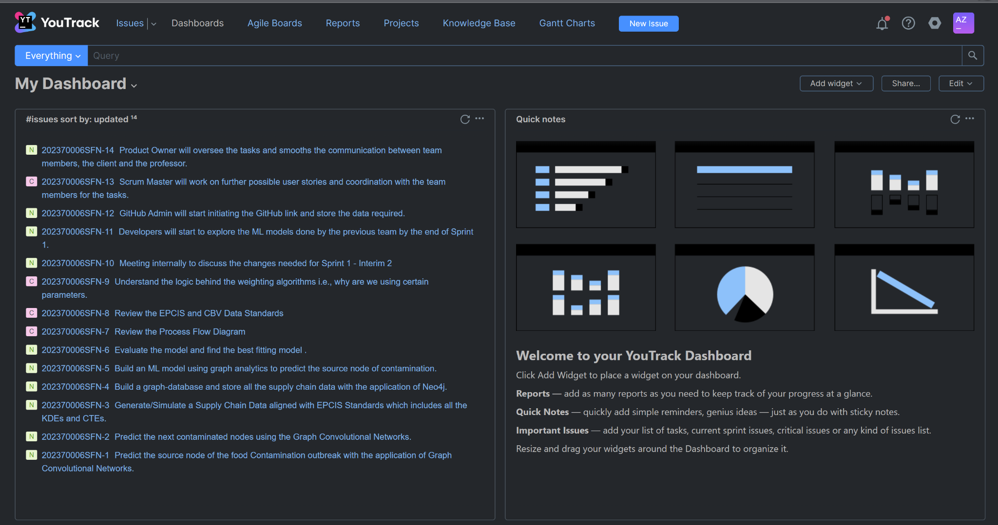
YOUTRACK: Dashboard

Slide 4
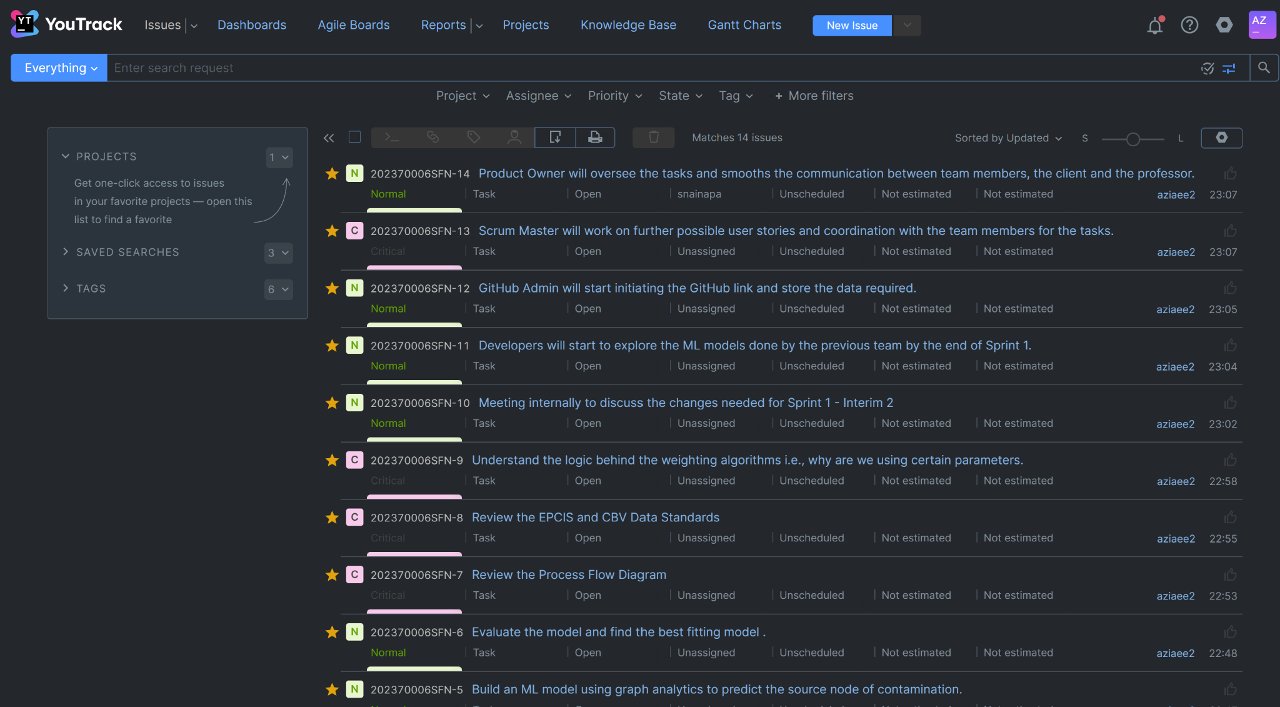
YOUTRACK: Issues Created, Categorized, and Assigned

Slide 5
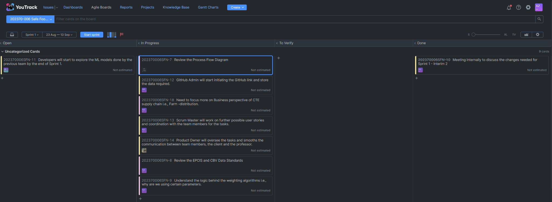
YOUTRACK: Sprint 1 Tasks Identified and assigned and Made Progress

Slide 6
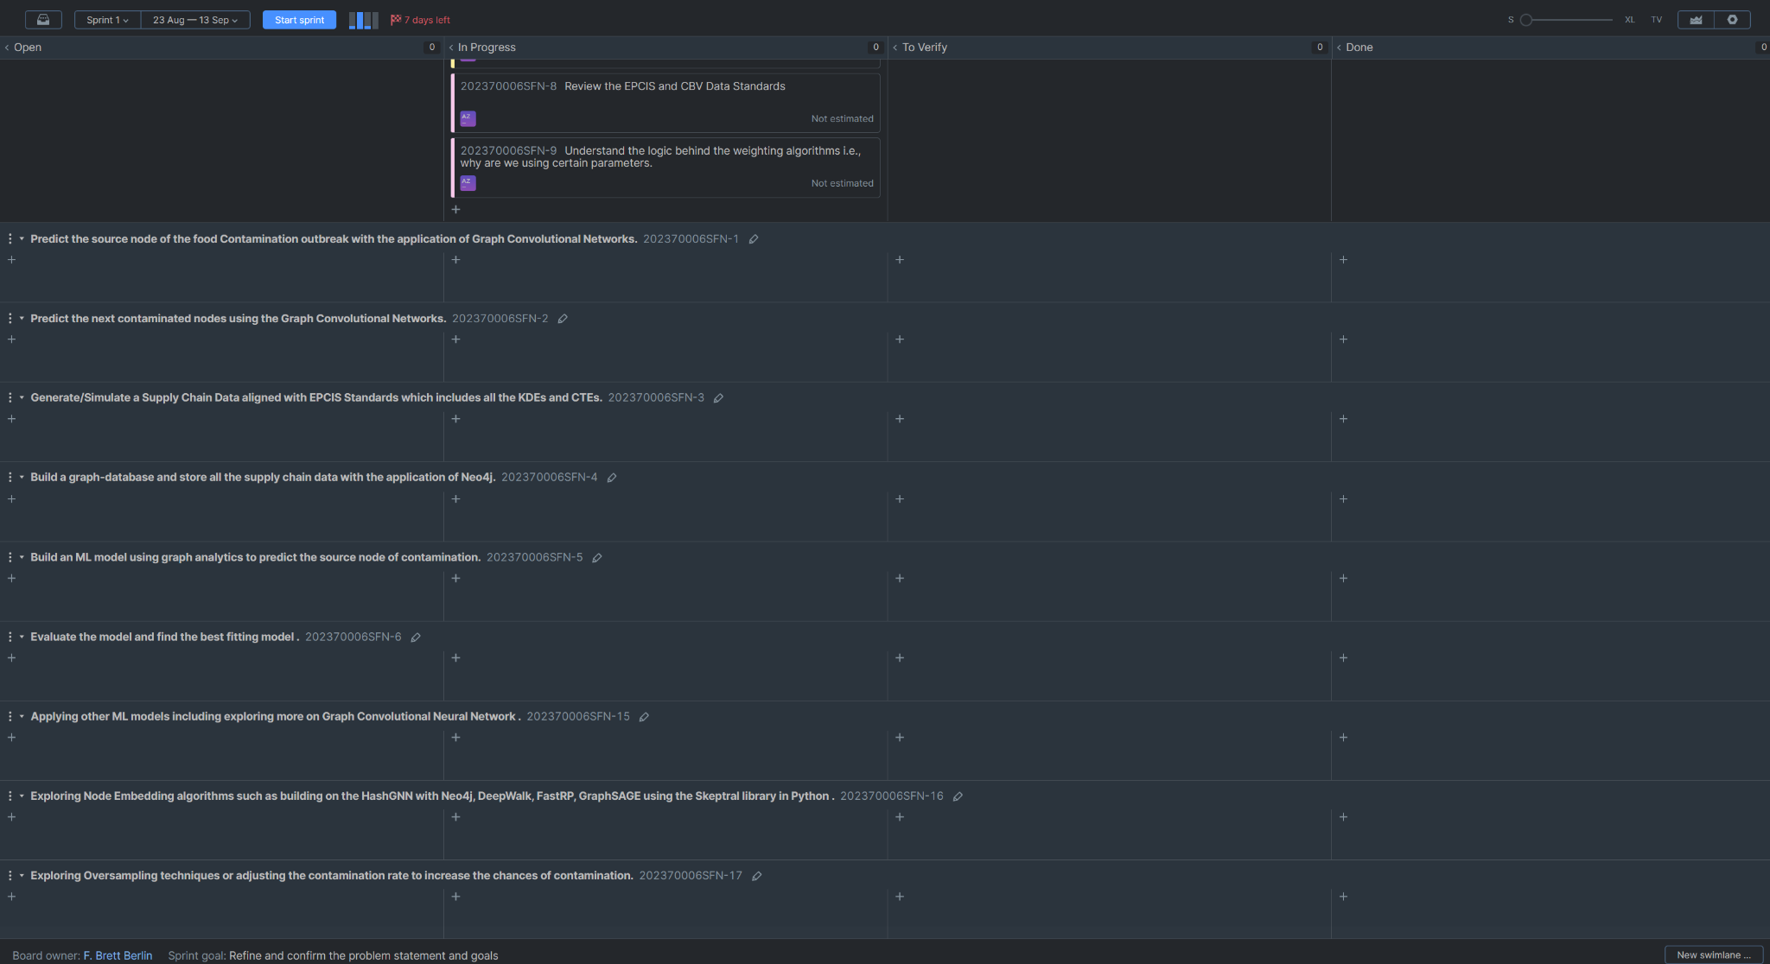
YOUTRACK: Sprint 1 User Stories Defined

Slide 7
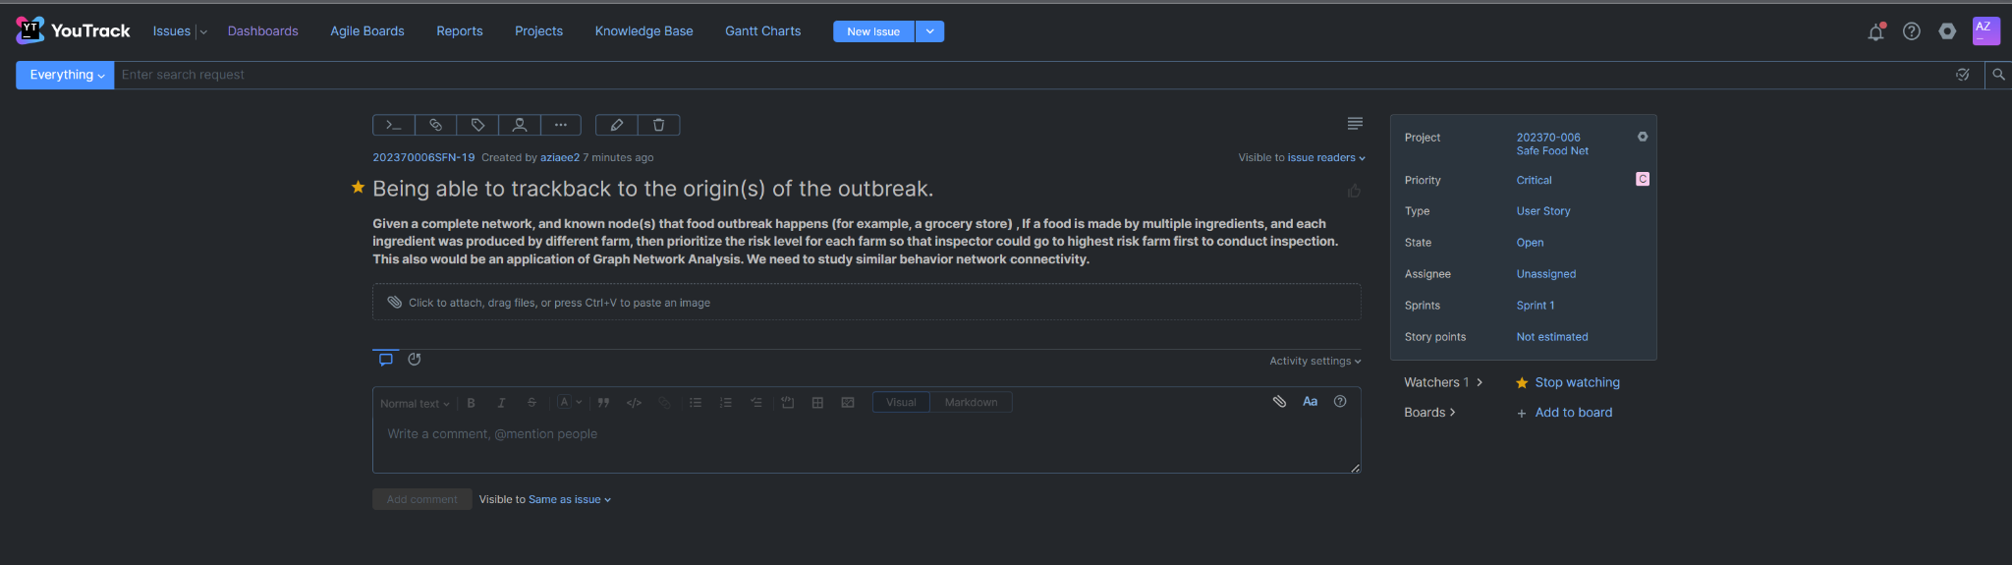
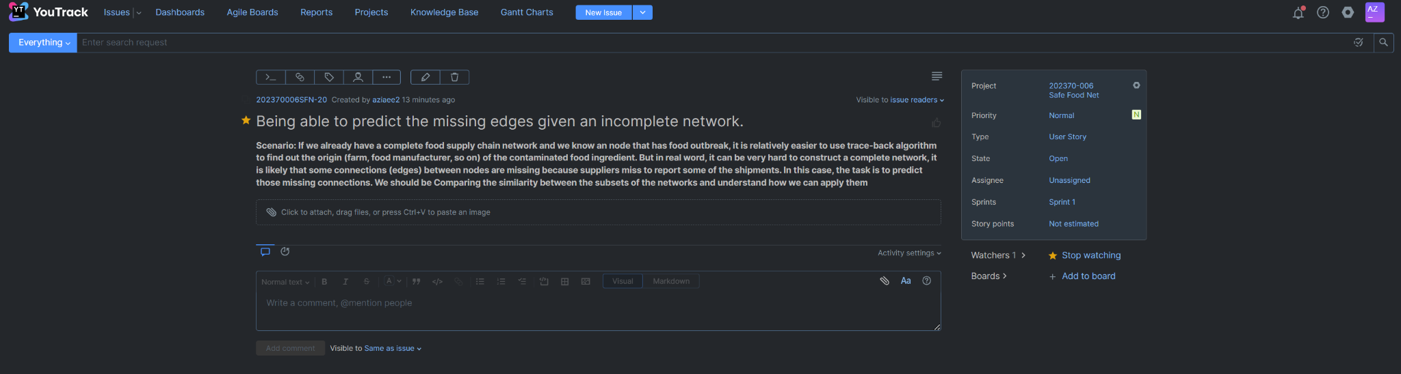
Additional Requirements proposed by the client and new User Stories created accordingly

Slide 8
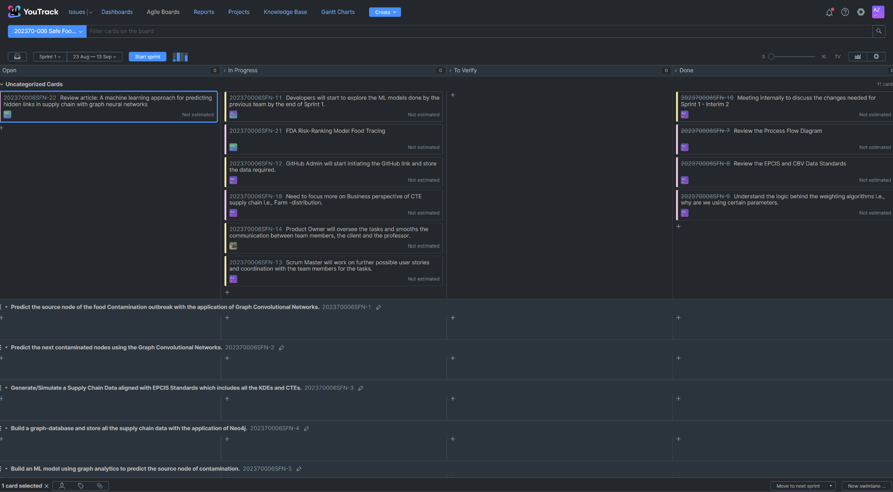
End of Sprint 1

Slide 9
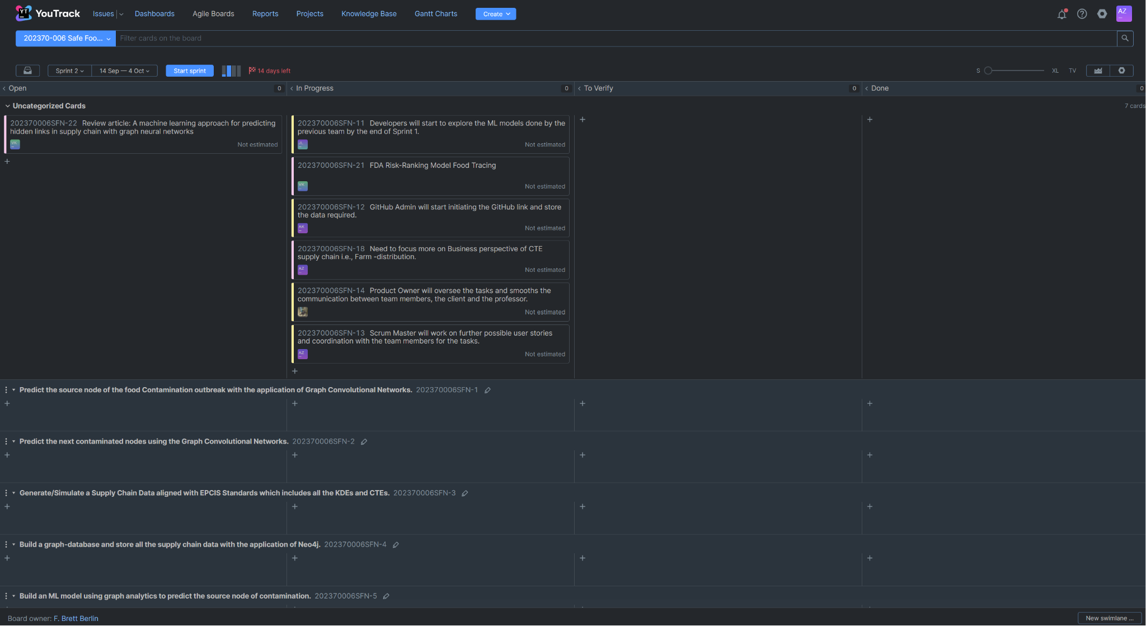
Sprint 2 Kicked off

Slide 10
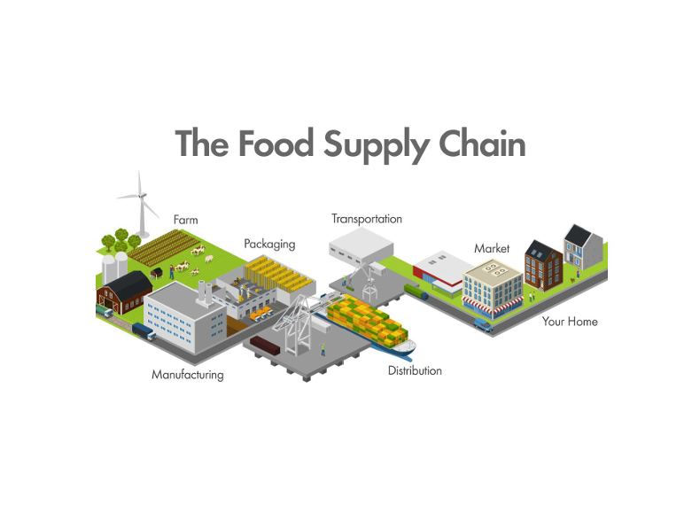
PROBLEM STATEMENT
Food traceability is a critical aspect of modern food production and distribution systems, aiming to ensure transparency, safety, and quality throughout the entire supply chain.
The problem of food traceability revolves around the accurate and efficient tracking of food products from their origin which means farm or manufacturer through various intermediary stages (i.e. processing, distribution, packaging) until they reach the end consumer.
This problem statement seeks to address the overarching issues within food traceability analysis, including the limitations of existing systems, technological barriers, regulatory compliance, and the impact of traceability on various stakeholders.

Slide 11
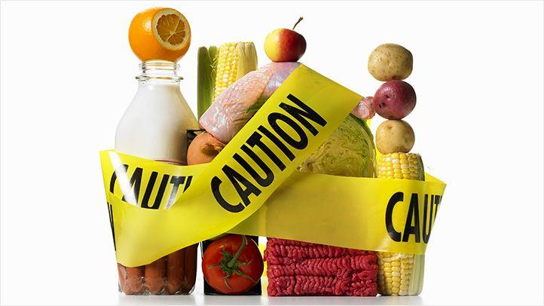
Foodborne Diseases Contamination
Foodborne disease contamination occurs when hazardous pathogens such as bacteria, viruses, or parasites infect food, causing illness when consumed. Undercooked meat, unpasteurized dairy, and contaminated fruit are common contributors.
There are two different types of contamination we accounted for: root contamination and cross-contamination.
At root contamination, a food item can become infected on its own and so become the root node for additional contamination at a facility.
Cross-contamination happens when a contaminated food item comes into contact with other items, spreading the contamination.
To avoid such contamination and accompanying health hazards, proper food handling, cooking, and cleanliness are required.

Slide 12
PRODUCT VISION
A project Vision for food traceability would encompass the overarching goals , objectives, and principles that guide the development and implementation of a comprehensive food traceability system.
Food traceability is essential for ensuring food safety, quality, and sustainability, as well as for meeting consumer demand for transparency in the food supply chain.
Here's the project vision for food traceability.
Ensuring Food safety
Enhancing food quality
Promoting Sustainability
Empowering consumer choice
Strengthening Trust and accountability
Industry Collaboration
Leveraging Technology
Regulatory Compliance
Global Reach
Continuous Improvement
Enhance Transparency
Promote Sustainability
Streamline Supply Chains
Enable Compliance
Foster Innovation
Empower Stakeholders

Slide 13
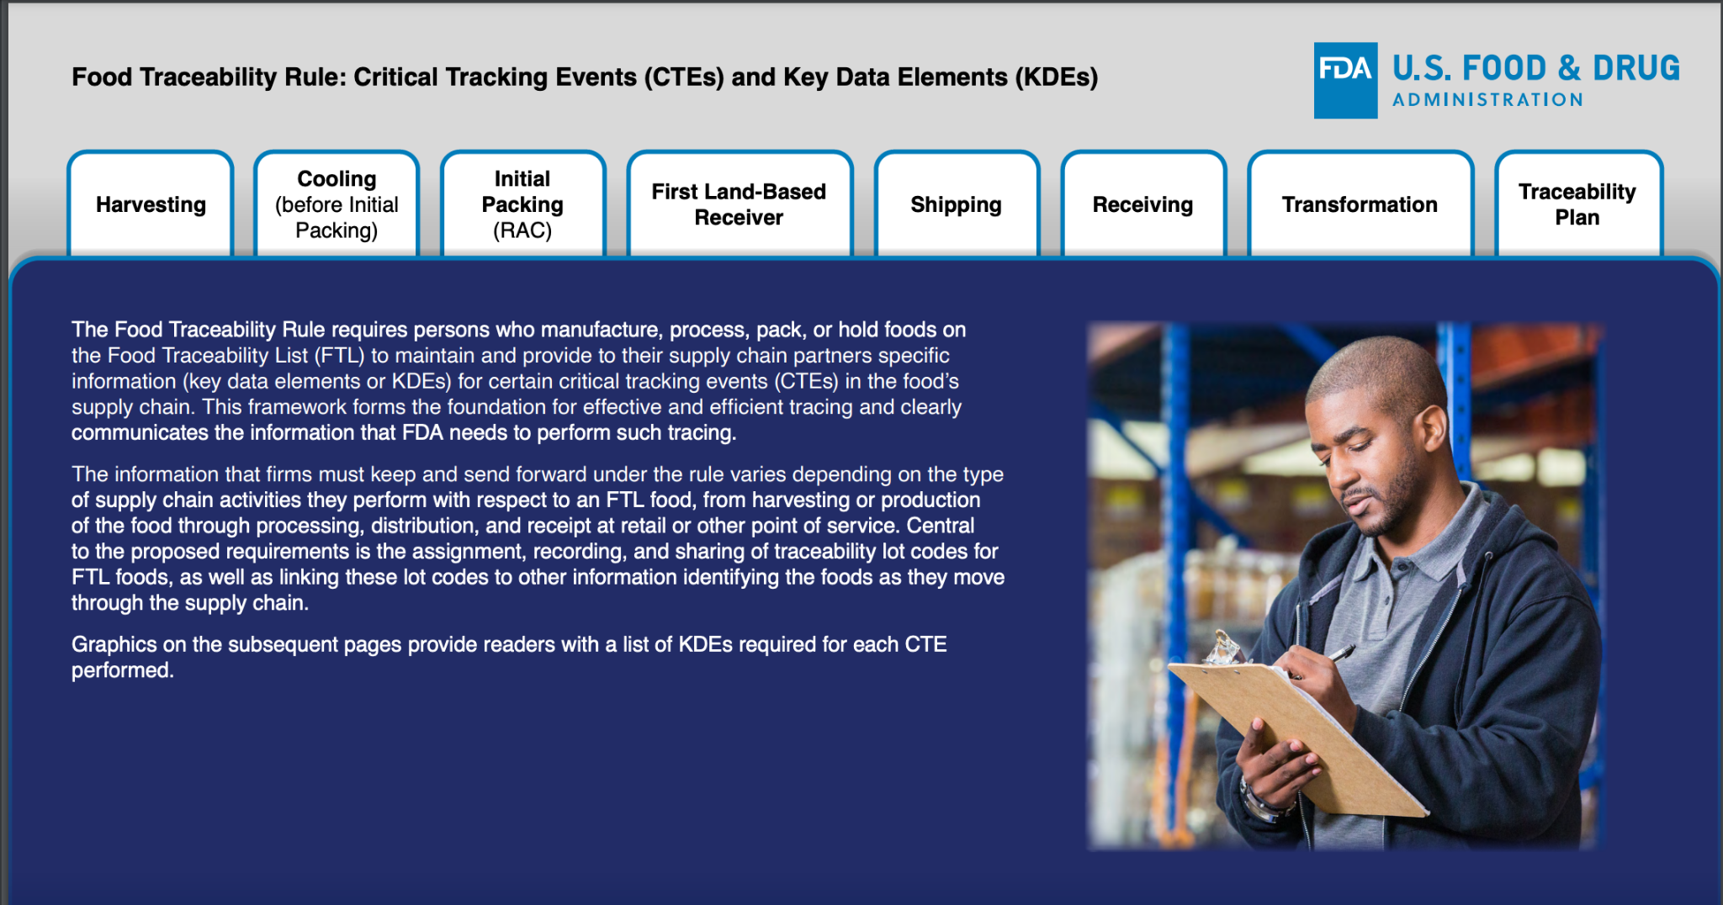
FOOD TRACEABILITY RULE

Slide 14
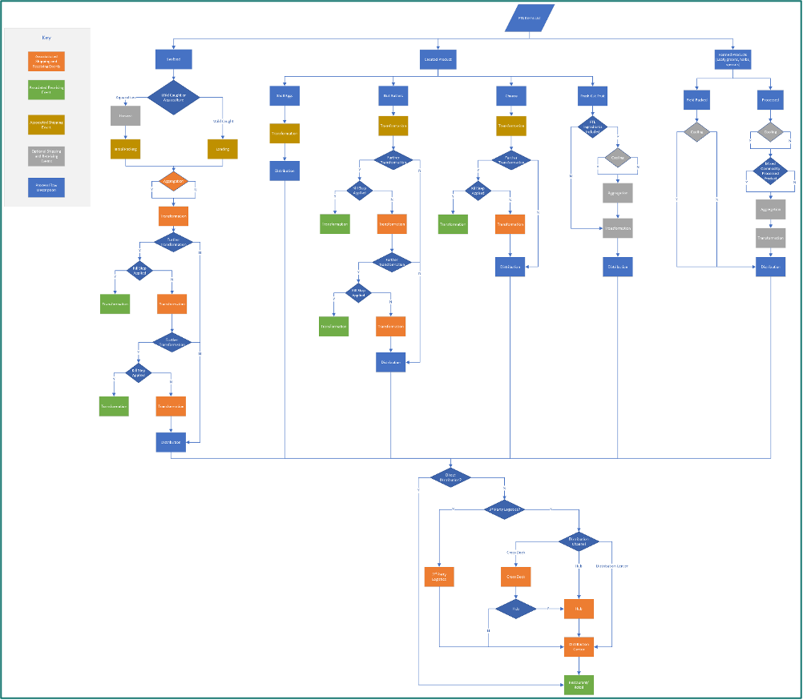
SUPPLY CHAIN DECISION GRAPH
A food item is chosen at random and then transmitted through the supply chain in the Supply Chain Simulation stage.
A detailed supply chain flow chart was produced in collaboration with Precise Software Solutions to depict the paths that a food item may follow.

Slide 15
POTENTIAL ANALYTICS/ALGORITHMS
Analytic/Algorithm Name:Data Analysis,Data Engineering,Data Visualisation,Data Modeling.
Programming & Scripting Languages: Python (Faker,random Packages).
Visualization:Neo4j Desktop.
Machine Learning Models: Logistic Regression, XG Boost
Node Embedding algorithms: Node2Vec , HashGNN.
Computer Resources Required: large CPU; GPU; cloud resources; laptop; etc.

Slide 16
SOLUTION SPACE
The solution space encompasses addressing two primary challenges. Initially, it involves generating simulated supply chain data due to the absence of actual real-world supply chain data.Exploring various data population techniques to generate realistic data points that mimic real-world supply chain scenarios.Utilizing pre-existing data generators to create additional data from the limited available real-world data. Gaining insights from sample real-world data to understand input data characteristics.
Approaches to Data Generation:
Python Workflow with 'Faker' and 'Random' Packages
User-Friendly Interface with 'Dash' Library
Python API with Customizable Features
Implementing a terminal application that accepts user input for the number of business entities and food items to simulate.Offered multiple approaches to data generation, providing flexibility and customization.Ensured data completeness, uniqueness, and conformity to industry standards.Facilitated ease of data generation through user-friendly interfaces.Enabled future use of the Python API for similar projects.

Slide 17
PROJECT OBJECTIVES
To identify where in the supply chain the contaminants are likely to occur.
To forecast potential model outcomes using node embedding methods and without them.
To utilize the application of ML models to forecast the business value of a foodborne outbreak at particular supply chain nodes.
To build a database of graphs to help with traceback and trace forward diagrams. The team should be able to learn about graph database technology
To create an interactive, visual diagram that represents the full supply chain for certain products and food items utilizing graph database technology.
The entire solution entails storing the supply chain data in a graph database like Neo4j, using this data to create and put into use machine learning models that accurately forecast polluted nodes in a supply chain, and then integrating all of these components.
Being able to trackback to the origin(s) of the outbreak.
Being able to predict the missing edges given an incomplete network.

Slide 18
DATA CONTEXT
In response to how challenging and time-consuming it is to identify the source of food contamination in convoluted supply chains, the FDA has developed a food traceability rule. Beyond what is already required by law, this rule requires businesses and organizations working in the food industry to keep documents pertaining to food traceability. A variety of enterprises, including businesses, farms, retail food establishments, and restaurants, are subject to this obligation.

Slide 19
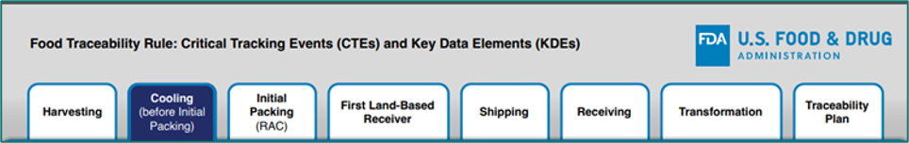
FIELD DESCRIPTION
The Food Traceability Rule requires those who produce, process, pack, or hold foods listed on the Food Traceability List (FTL) to keep track of and give their supply chain partners specific data (known as key data elements, or KDEs) for a number of critical tracking events (CTEs) in the food's supply chain. Every significant tracking event in the supply chain, including harvesting, cooling, first packing, first land-based receiver, shipping, receipt, and transformation. This framework provides the FDA with all the information required to set up food traceability and serves as the cornerstone for successful and efficient food tracing across the supply chain.

Slide 20
DATASETS OVERVIEW
Data about Critical Tracking Events (CTEs) and the Key Data Elements (KDEs) that go with them are contained in the Traceability Rule. Dataset includes a variety of CTEs, including initial packaging, cooling, and harvesting. At particular points in the supply chain, including the initial packing step, the food product is given a special code known as the Traceability Lot Code (TLC). At any stage in the supply chain, this TLC acts as a unique identification for a specific commodity.The column names in the dataset will be renamed for better understanding and reference in order to increase simplicity and clarity.
DATASET LINK:
https://github.com/jcusworth1/GMU-DAEN690-FoodTraceability/tree/main/data_generation

Slide 21
SPRINT 2 RISK
Risk Name | Description | Probability | Impact | Mitigation
Mapping CTE Events | Mapping each CTE event to next event to form supply chain | High | High | Focus on small data sample, construct end-to-end supply chain

Slide 22
PROJECT SCHEDULE
Date | Week | Task
September 20,2023 | 1 | Identify & Analyse the Datasets ,Previously generated Data
September 27,2023 | 2 | Assessment of Data generated and identify new CTEs and generate data and replicate the previous work .
October 4,2023 | 3 | Final: Complete the data generation and finalise the report.

Slide 23
WEEKLY PARTNER MEETING
Partner name : Precise Solutions
Team Progress from Prior Week
The current In Progress tasks were worked on and changed to Done
All new tasks were assigned, prioritized, and made progress on
New User stories and tasks were defined based on the client meeting
Sprint 2 kicked off and the draft report and presentation created accordingly
Team Tasks for Current Week
Review the ‘FDA’s Risk-Ranking Model Food Tracing’ (Requested by the client)
Review the article ‘A machine learning approach for predicting hidden links in supply chain with graph neural networks’ (Requested by Professor Ben)
Work on the datasets generation/simulation
Generating local Graph DBMS in Neo4J
Meeting internally to discuss the changes needed for Sprint 2
Developers will start to explore the ML models done by the previous team
GitHub Admin will develop the GitHub link and store the data required
Scrum Master will work on further possible user stories and coordination with the team members for the current/future tasks
Product Owner will oversee the tasks and smooths the communication between team members, the client and the professor
Other Items Discussed
The two scenarios/ use cases Professor Ben sent out through email
The DA’s Risk-Ranking Model Food Tracing and how it addresses the use case that professor Ben sent out

Slide 24
References
[1].Center for Food Safety and Applied Nutrition. (n.d.-a). Investigations of foodborne illness outbreaks. U.S. Food and Drug Administration. https://www.fda.gov/food/outbreaks-foodborne-illness/investigations-foodborne-illness-outbreaks
[2].Center for Food Safety and Applied Nutrition. (n.d.-b). Outbreaks of foodborne illness. U.S. Food and Drug Administration. https://www.fda.gov/food/recalls-outbreaks-emergencies/outbreaks-foodborne-illness
[3].Centers for Disease Control and Prevention. (2023, August 31). Foodborne outbreaks. Centers for Disease Control and Prevention. https://www.cdc.gov/foodsafety/outbreaks/index.html
[4].Communicable disease report for healthcare providers. (n.d.-a). https://www.azdhs.gov/documents/preparedness/epidemiology-disease-control/disease-investigation-resources/communicable-disease-report-form.pdf
[5].Foodborne disease outbreaks. Environmental Health. (2017, February 24).https://www.vdh.virginia.gov/environmental-health/food-safety-in-virginia/foodborne-diseases-and-outbreaks/foodborne-outbreaks/
[6].introduction to foodborne illness outbreak investigations - books. (n.d.-b). https://ajph.aphapublications.org/doi/full/10.2105/9780875532943ch13
[7]. Research on the application of big data in smart food Safety. (2020, September 1). IEEE Conference Publication | IEEE Xplore. https://ieeexplore.ieee.org/document/9546382
[8]. Study on Microwave Food Contamination Examination based on Machine Learning approach. (2022, December 11). IEEE Conference Publication | IEEE Xplore. https://ieeexplore.ieee.org/document/10015961

Slide 25
Thank You

